Slide 1
Real Estate Price Prediction using Machine Learning
Emmanuel Layade

Slide 2
Introduction
Predicting real estate prices is a complex task that has traditionally relied on the expertise of human appraisers and real estate agents. With the advent of machine learning algorithms, however, it has become possible to automate the process and generate more accurate predictions. In this presentation, we will explore the use of machine learning in predicting real estate prices

Slide 3
Dataset
The dataset contains 25 columns with information about real estate properties, including features like number of bedrooms and bathrooms, square footage, property type, year built, and lot size. It also includes demographic information such as median age, college graduation rates, and number of schools in the area, as well as financial details like property tax, insurance, and median school ratings. Additionally, the dataset provides data on the surrounding area, including the number of nearby restaurants, groceries, nightlife options, and other amenities.

Slide 4
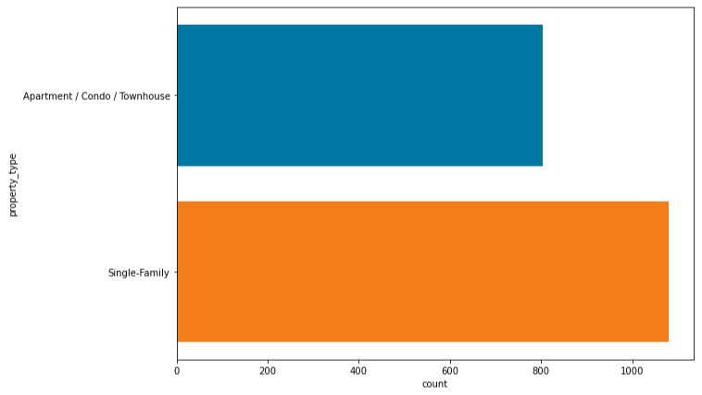
Exploratory Data Analysis
Exploratory data analysis helped to identify several important factors that could potentially affect the price of real estate properties, including location, property type, and the number of nearby amenities.

Slide 5
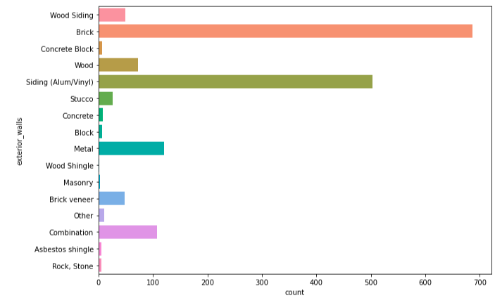
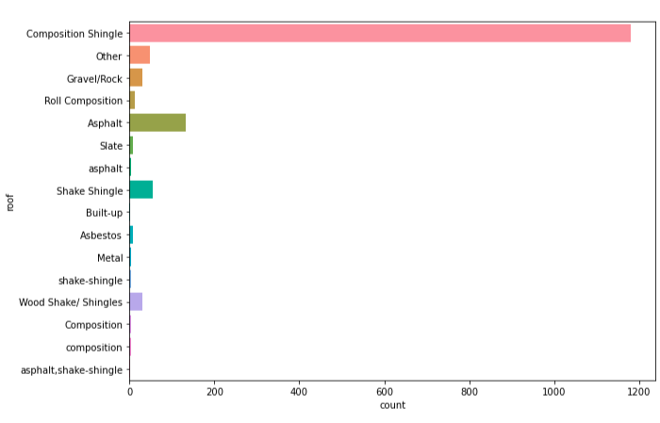
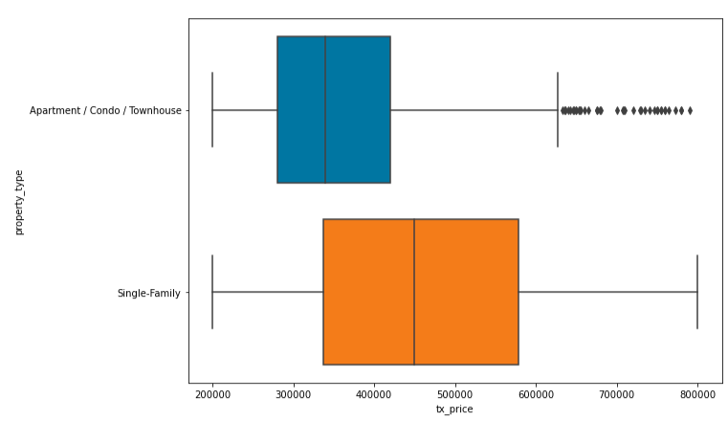
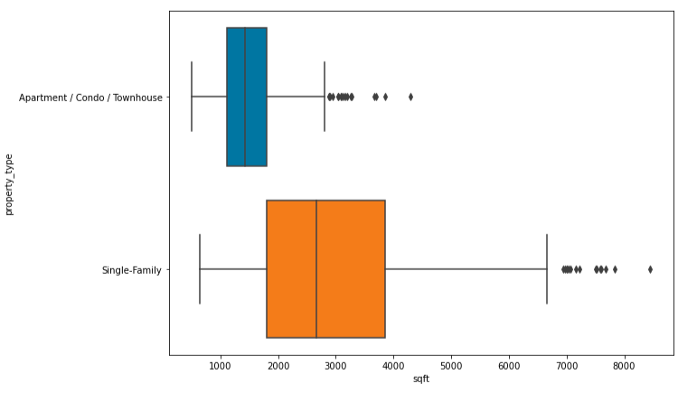

Slide 6
Data Cleaning
In the data cleaning process of the house price dataset, I removed duplicate values to ensure data accuracy and reliability. Additionally, I filled the missing values with zeros and removed irrelevant information to ensure data completeness and consistency.

Slide 7
Feature Engineering
The feature engineering process involved creating two new columns: age of the house and school_score. The age of the house was calculated by subtracting the year_built column from the tx_year column. The school_score column was created by multiplying the num_schools column with the median_school column.
Furthermore, one hot encoding was applied to the categorical columns, such as property_type, exterior_walls, and roof, in order to convert them into numerical features that could be used in machine learning algorithms.

Slide 8
Model Training
Four different machine learning algorithms are trained on the dataset of the house to predict the price of the house. Following algorithms are trained:
Linear Regression
Random Forest
Decision Tree
Support Vector Machine

Slide 9
Accuracy of Models
After training the algorithms the accuracy of the algorithms are computed using R2-score below are the results of each algorithm.
Random forest has the highest R2-Score value as compare to other models.
Model | R2-Score
Linear Regression | 0.40
Random Forest | 0.55
Decision Tree | 0.02
Support Vector Machine | 0.03

Slide 10
Price Prediction of Models
After training the test data is passed to predict the price of house based on input below are the results of the predictions of models. Linear Regression model shows the very results on the testing dataset.
Model | Prediction
Linear Regression | -1.2817
Decision Tree | 279875
Random Forest | 537872
Support Vector Machine | 395033

Slide 11
Conclusion
House Price dataset was used to predict the price of house using different machine learning algorithms. Different machine learning algorithms were trained on this dataset, but only decision tree shows the confident results as compare to other algorithms.

